Slide 1
Aproximation Methods Project - Numerical Results

Slide 2
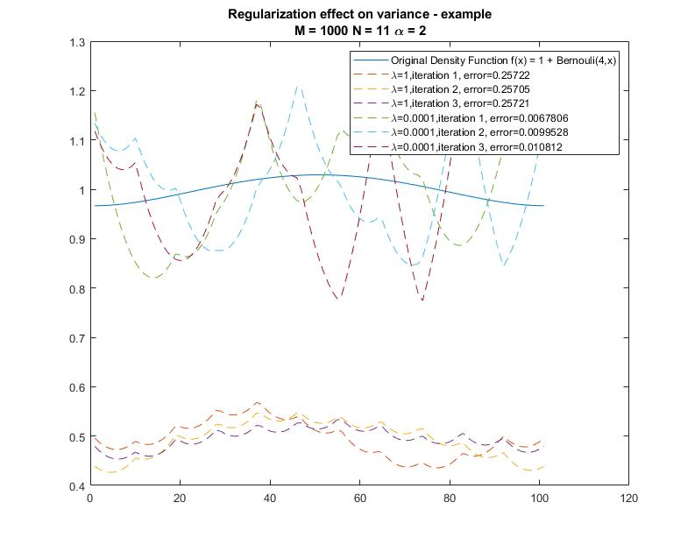
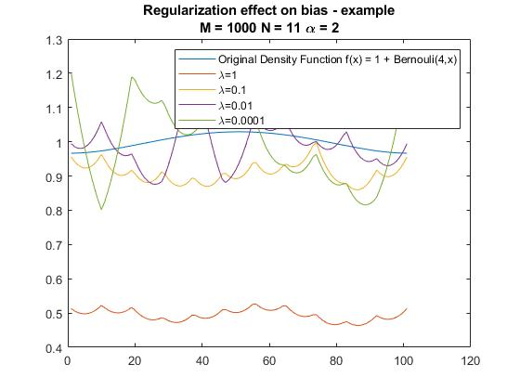
Regularization Effect on Bias and Variance - Example
A larger Regularization parameter 𝝀 reduces the variance of the MISE error while introducing a bias to the error

Slide 3
Density Function Smoothness Effect on approximation
Using Korobov Kernel (with d = 1 𝛼 = 4), the first two functions are the first two levels of the B-spline: B₀ , B₁ (which are non continuous and C₀) are not in the korobov space and hence they have a relatively large projection error onto N_{kor}, the second two functions however (B₂ , B₃) are in the korobov space. The example was run with M = ∞, N = 50 (which is enough points N for d=1 to get little to no projection error from N_{kor} to V_{n}) and no regularization, in that case we expect the estimation error to be solely from the projection error onto N_{kor}.

Slide 4
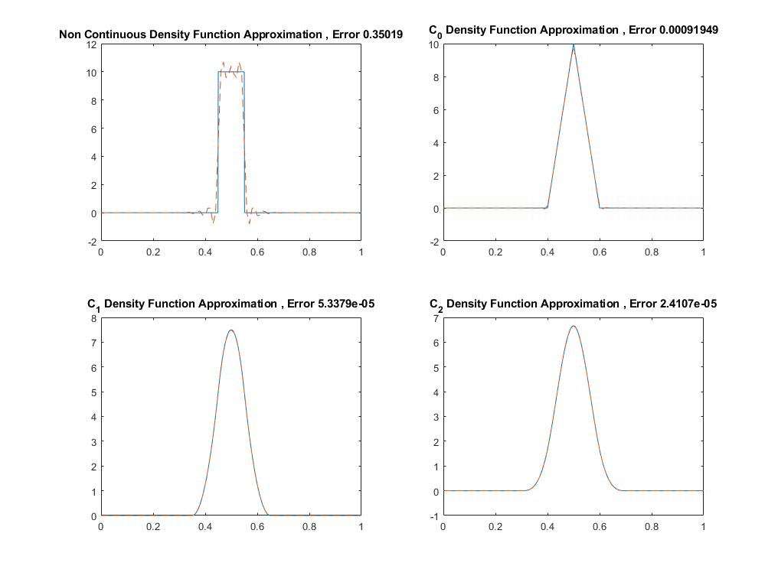
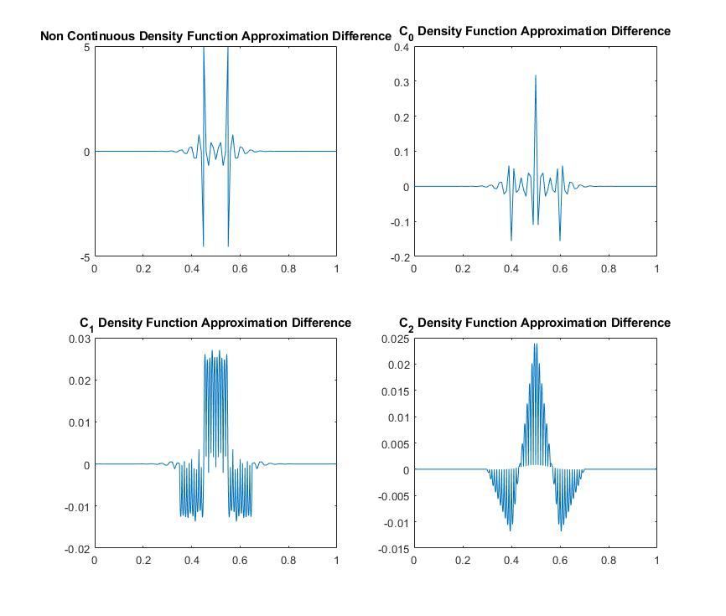
Density Function Smoothness Effect on approximation

Slide 5
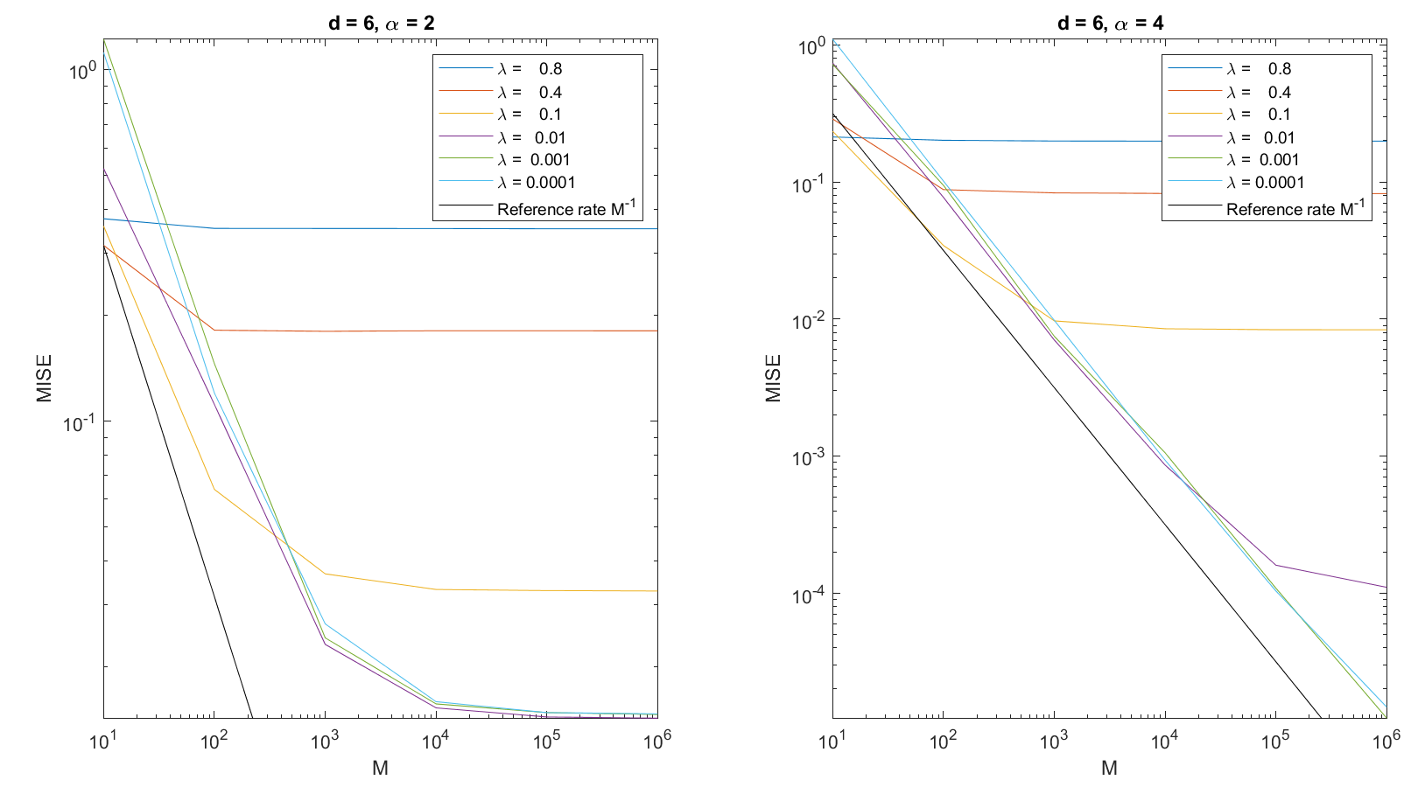
Paper results - Varying sample size M with various regularization values

Slide 6
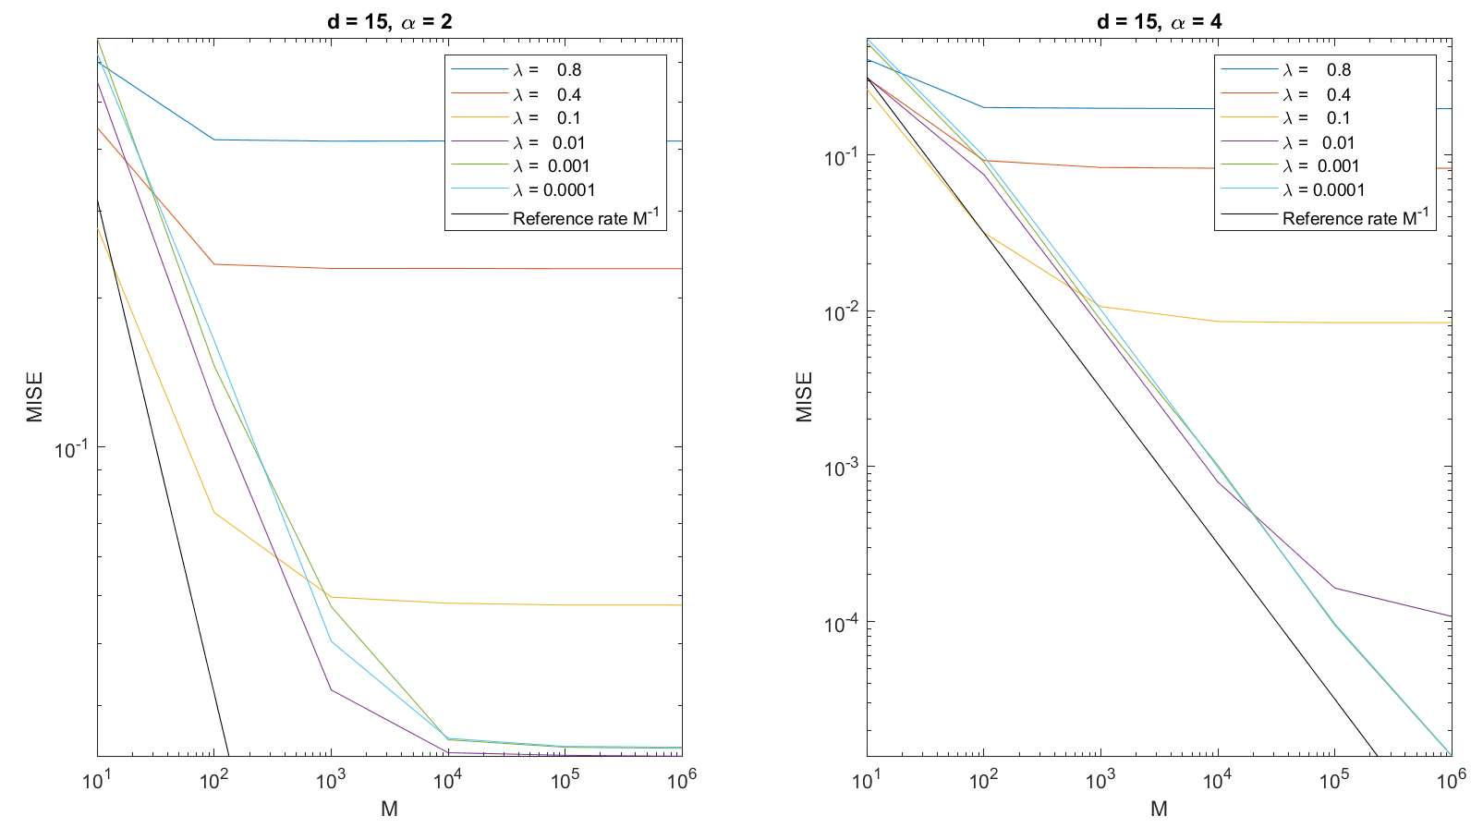
Paper results - Varying sample size M with various regularization values

Slide 7
Paper results - Varying sample size M with various regularization values
The graphs support the claims of the paper: for large M values the MISE error decays with 𝜆 since the variance error term is negligible compared to the bias error term from the regularization. For small values of M the variance term is the dominant error term and hence lower values of 𝜆 give high MISE error. The above mise error graphs are approximately the same for different dimension size (d=6,d=15) which supports the paper’s claim for error rate independent of d.

Slide 8
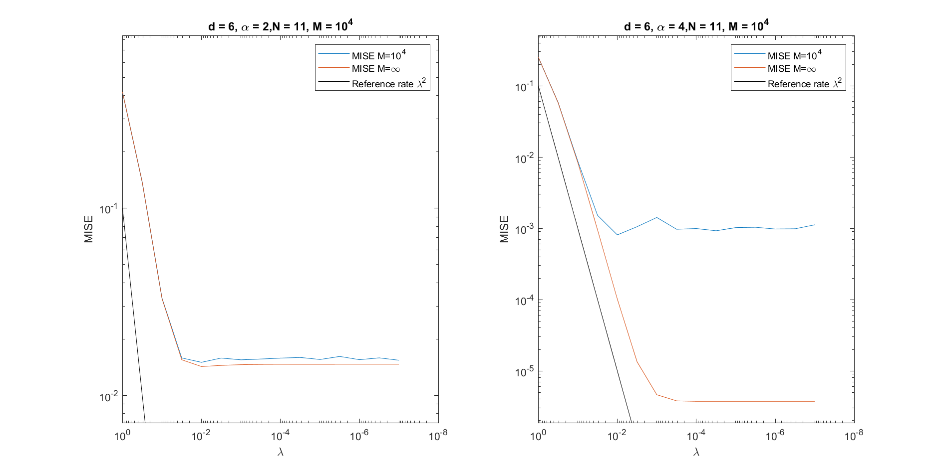
Paper results - Varying the regularization value 𝜆

Slide 9
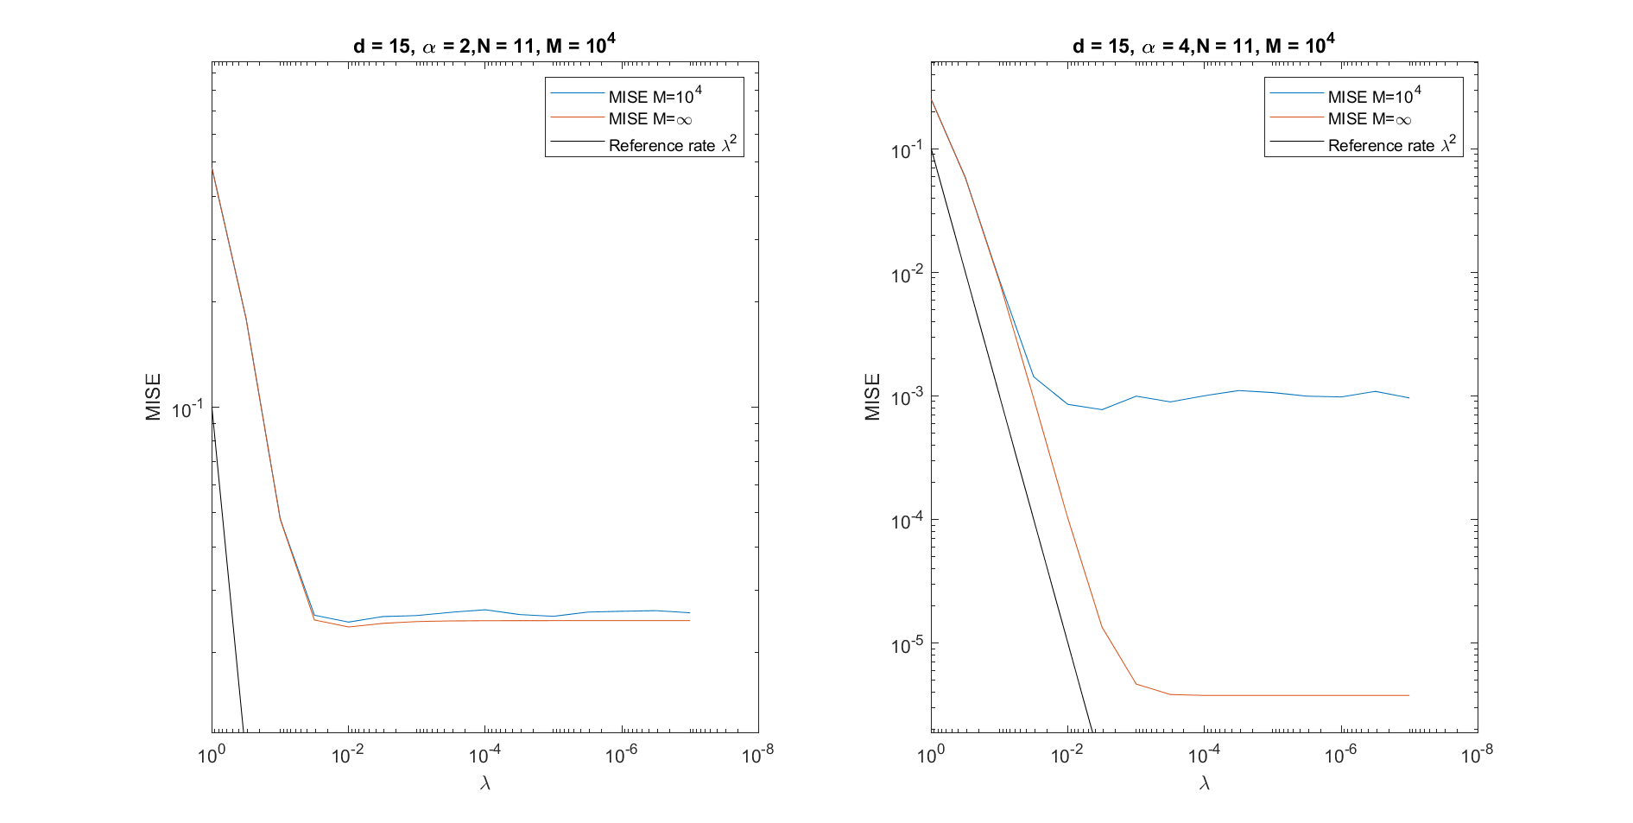
Paper results - Varying the regularization value 𝜆

Slide 10
Paper results - Varying the regularization value 𝜆
The graphs shows quadratic decay of the MISE error in 𝜆 until it reaches a plateau. When 𝜆 is very small the remaining error consists of projection error and variance term error. In addition to the case of M = 10⁴ an iteration was run with M = ∞ (by calculating the L2 inner product between f(x) and the K(ᐧ , x_{j}) instead of averaging over K(Y_{i} , x_{j}) ). For M = ∞, the MISE error continuous to decay quadratically in 𝜆 until it reaches a lower plateau, the remaining error in that case consists only of the projection error. The projection error for 𝛼 = 2 is much larger then 𝛼 = 4 since the density function that was used is a product of 1 + C Bern₄(x) in each dimension.

Slide 11
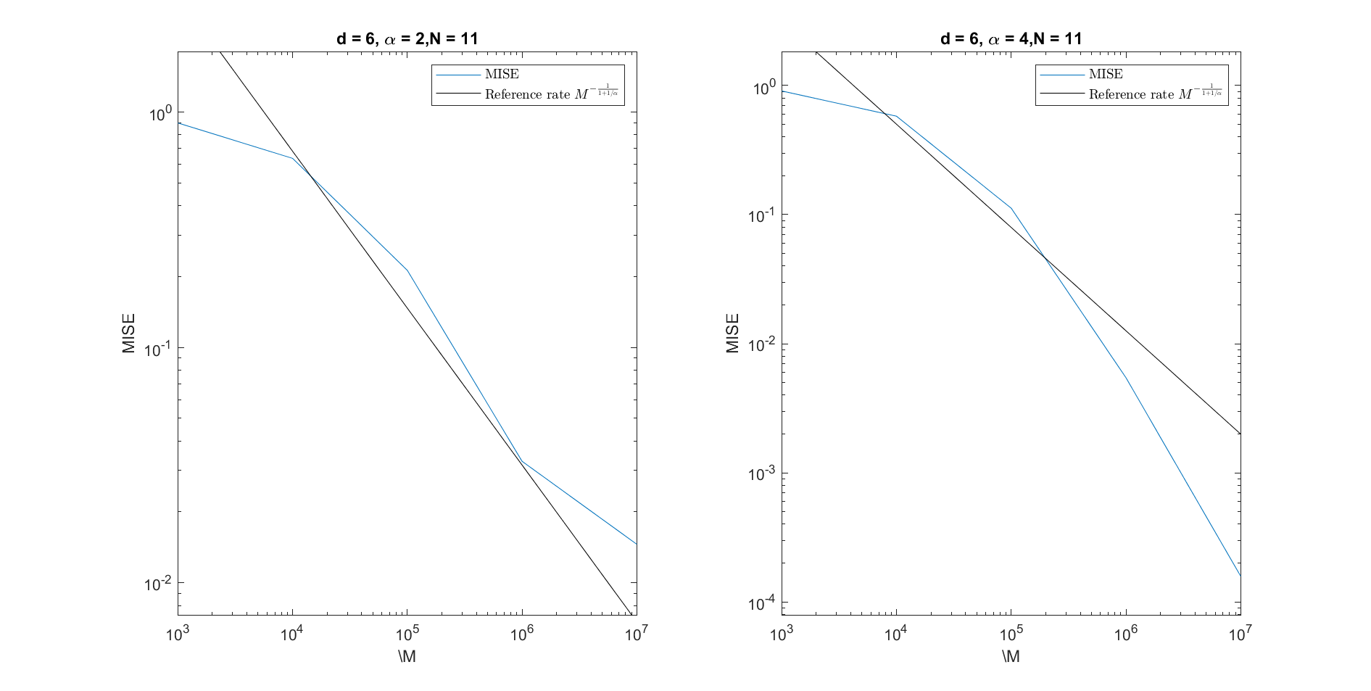
Paper results - Varying sample Size M with optimal 𝜆

Slide 12
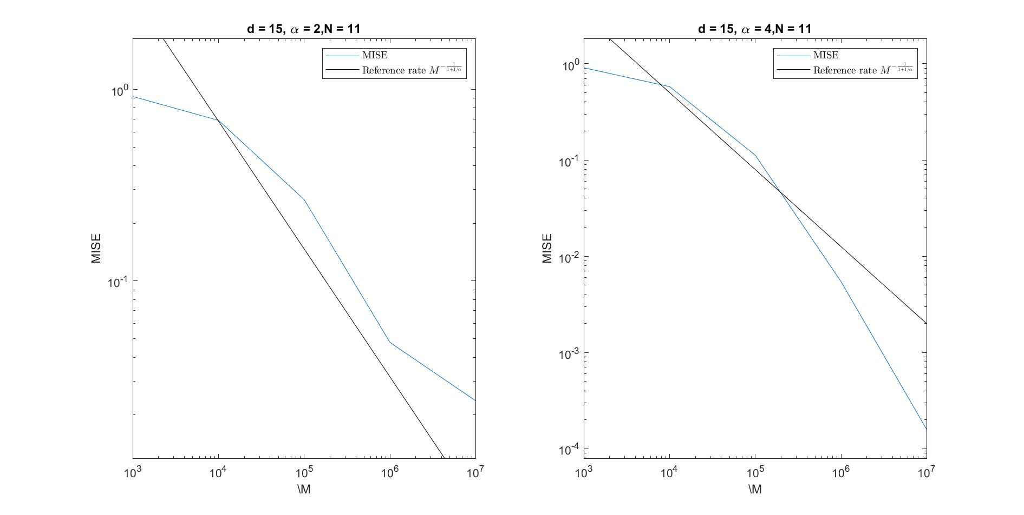
Paper results - Varying sample Size M with optimal 𝜆

Slide 13




Paper results - Varying sample Size M with optimal 𝜆
Using optimal decay of the regularization value ,more specifically
for 𝛼 = 2 and for 𝛼 = 4 we get a MISE error rate of approximately as claimed by the paper.

